Slide 1

History 382 Mini-Lecture: The Rules of Colonial American Capitalism: Mercantilism, War Capitalism, and the Organic Economy

Slide 2
“Rules”
Mercantilism
War Capitalism
Organic Economy
[Should be able to define these terms]

Slide 3
Political Economy
Economics and State policy are linked together

Slide 4
Mercantilism
A system of political economy based on empire
Based on idea of a zero-sum competition between European nations
Purpose of trade is to benefit the mother country
Emphasizes balance of trade (do you bring in more gold and silver to the mother country than you send out?)
Periphery supplies raw materials to mother country, which processes these raw materials

Slide 5
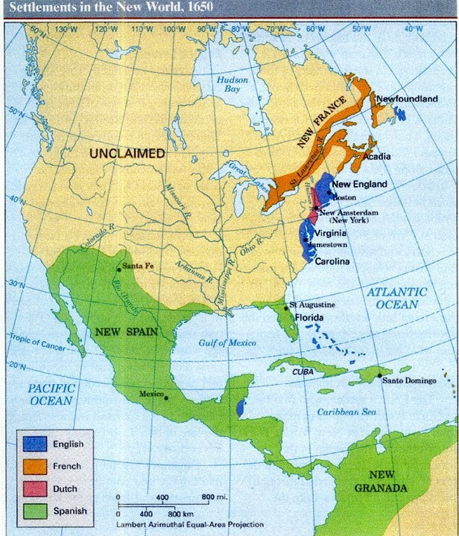
European Competition in the Americas

Slide 6
English Navigation Acts
1651 Navigation Act-trade from colonies must take place in British Ships
1660 Navigation Act- trade must be conducted in ships with an English Captain and crew at least 3 / 4th English
1663-Staples Act—all goods from colonies must stop in Britain first where they would be taxed
Colonies Make Efforts to Evade
By 1696 2/3 of English revenue comes from taxes and Revenues on foreign trade

Slide 7
War Capitalism
British Joint Stock Companies Empowered with military power (either private or from the state)
To Protect their Interests against European Rivals
To Impose Their Will on Local Populations

Slide 8
The Bargain of War Capitalism
Joint Stock Companies Get support of British State
Should Conduct their Enterprise in a way that Benefits Britain (and follow regulations made to that effect)

Slide 9
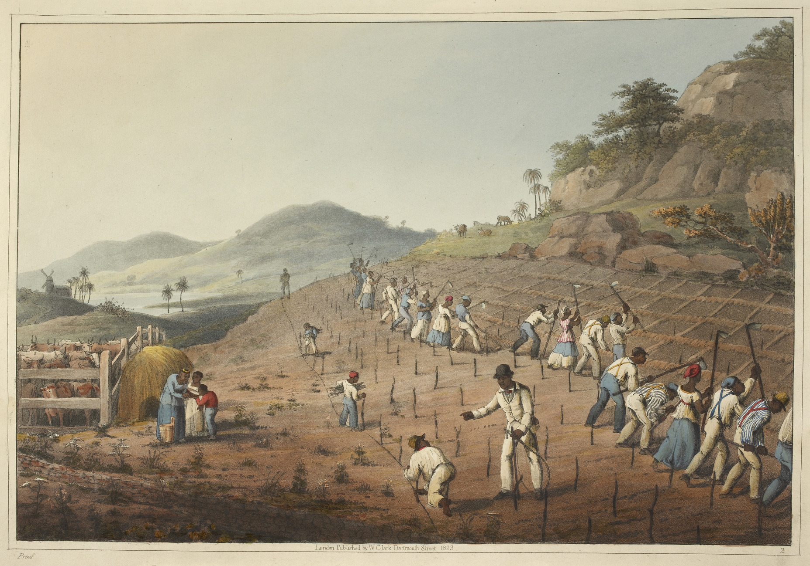
War Capitalism in the Atlantic World
English armed force imports slaves from Africa (mostly to Caribbean).
English armed force supports subjugation of native Americans

Slide 10
Sugar
Sugar, previously produced by Spain, Portugal in Canary Islands, Sao Tome
Luxury item for Europeans
Caribbean colonies begin large scale sugar production
Sugar becomes a common European food

Slide 11
Barbados “First Commercial Jewel of the English Atlantic”
Making sugar using enslaved people imported from Africa
130,000 from 1640-1700
New England becomes supplier of provisions to Barbados
New England imports English manufactures based on credits from Barbados

Slide 12
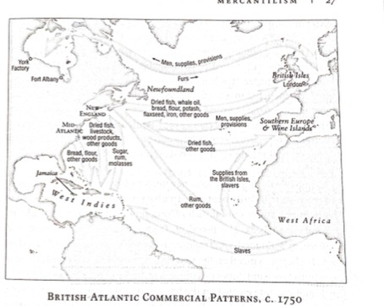
Trade in the Atlantic World

Slide 13
The Organic Economy
Society that gets its energy from products of photosynthesis (plants) either directly or indirectly (humans/animals)
Supplemented by wind/water power

Slide 14
Main (non-animate) energy source is wood

Slide 15
Energy Density of Fuels
Gasoline 46-47 MJ/kg
Bituminous Coal 27-29 MJ/kg
Wood 14-15 MJ/kg
Straw 12-15 Mj/kg
Feces 1.8-3.0 MJ/kg

Slide 16
Energy Costs of Common Materials
Titanium 900-940 MJ/kg
Aluminum 227-342 MJ/kg
Silicon 230-235 MJ/kg
Plastic 87-117 MJ/kg
Steel 20-50 MJ/kg
Wood 3-7
Bricks 2-5

Slide 17
The Organic Economy
--energy based on the amount of land
In England only 10% of land forested
Begun use of coal transitioning out of organic economy
In America, land, forests abundant

Slide 18
The Organic Economy in America
Land, forests abundant
Colonists recognize land important
Colonists have access to large amounts of wood-based energy
Europeans note the large (wasteful) fires Americans have
Metal still costly, difficult to produce
Coal not widely used until 1850s

Slide 19
Household as Center of Economy
On the whole the organic economy privileged the small-scale, the rural, the dispersed
The household was the center of the economy, whether in a plantation, the farm or the workshop

Slide 20
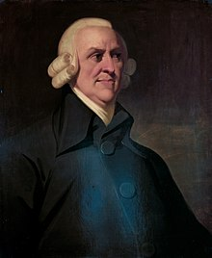
Adam Smith—Changing the Rules
Adam Smith
Born 1723 in Scotland
Scotland had become intellectual center of Great Britain (5 universities versus 2 in England)
Scottish Enlightenment
Teaching competitive classes Each professors pay based on students who elect to study with him

Slide 21
The Wealth of Nations (1776)
Applying a scientific approach to why some nations are wealthier than others.
Attempt to “demoralize economics”
Understand it as a science
Just as the universe seen as a clock work, subject to certain rules, human economic interactions can be seen in the same way
Attacks much conventional thinking
His answers:
1. Tendency of humans to trade (truck and barter)
2. Division of labor
3. Division of labor limited by extent of market

Slide 22
Attacks mercantilism
Raises prices for consumers
Attacks moral economy
Based on superstition.

Slide 23
His Answers
His answers:
1. Tendency of humans to trade (truck and barter)
2. Division of labor
3. Division of labor limited by extent of market

Slide 24
Tendency of Humans to Trade (Truck and Barter)
“It is not from the benevolence of the butcher, the brewer, or the baker that we expect our dinner, but from their regard to their own interest. We address ourselves, not to their humanity, but to their self-love, and never talk to them of our own necessities, but of their advantages. Nobody but a beggar chooses to depend chiefly upon the benevolence of his fellow-citizens.”
Trade can be Win-Win

Slide 25
Division of Labor
Gives Example of Pin Factory
One person not acquainted with pin making could hardly make one a day
Factory of 10 people making 48,000 pins a day

Slide 26
Division of Labor Limited by Extent of Market
When market is small, no one can specialize
In the Highlands of Scotland, everyone must be butcher, baker, brewer for their own family
In 18th century, extent of market enlarged by water transportation (overseas, and on rivers)

Slide 27
Smithian Growth
Combination of these three factors
Trade
Growing Extent of Market
Growing Division of Labor

Slide 28
War Capitalism and Adam Smith
War Capitalism
Increased markets
Allowed greater specialization (enslaved people)

Slide 29
In the Longer History of American Capitalism….
Mercantilism
Central to Colonial America Up to Revolution
War Capitalism
Continued even after American Revolution
Slavery, Removal of Native Americans, Mexican War
Organic Economy
Important up through 1850s and beyond

Slide 30
Adam Smith and The Wealth of Nations
Continued and growing importance in thinking about economics

